Slide 1


Polar Codes
Group 23

Slide 2
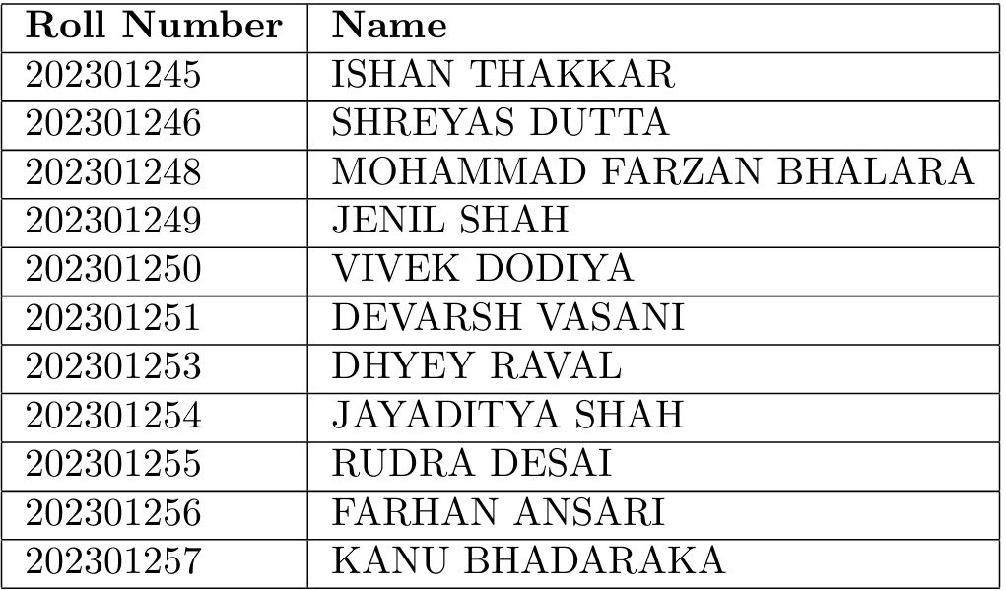

Slide 3


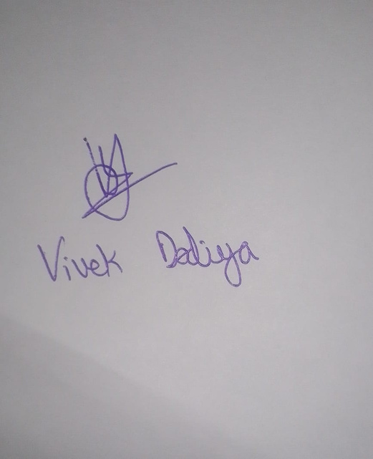
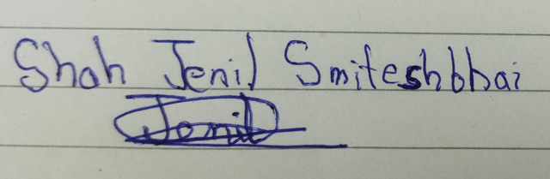
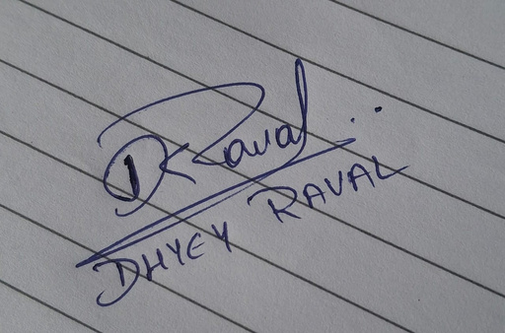
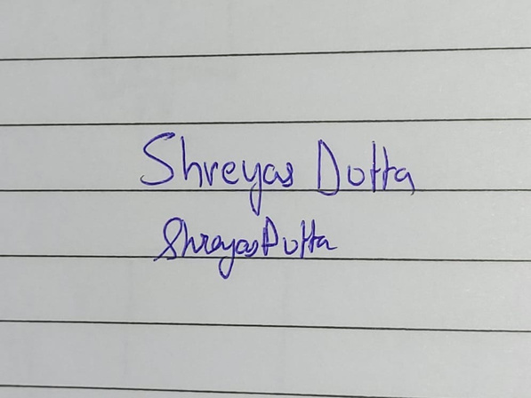
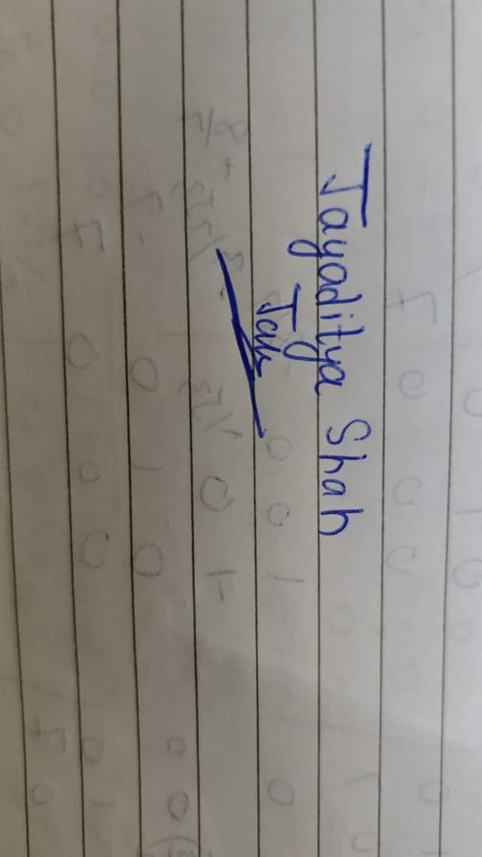
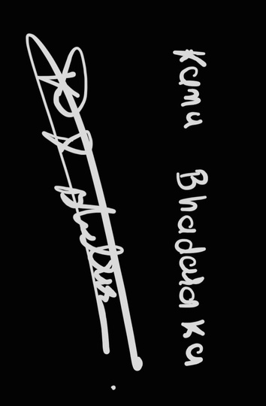
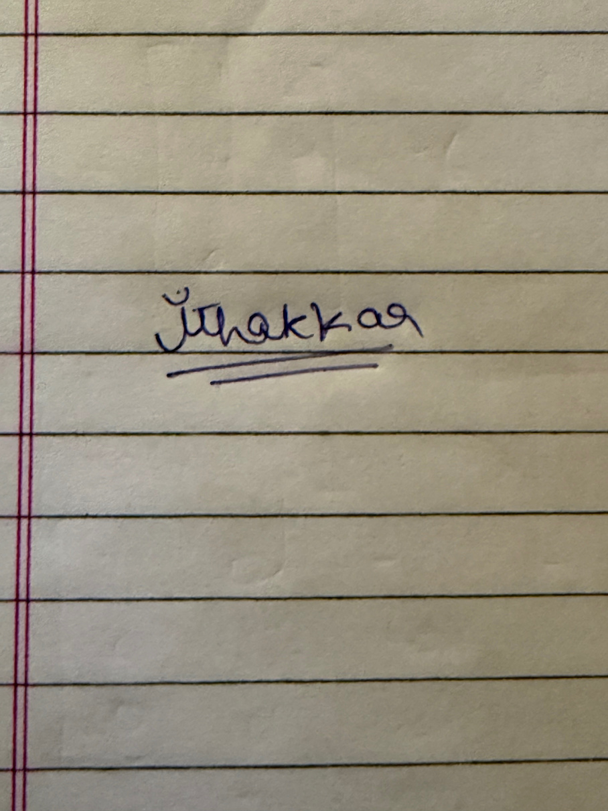
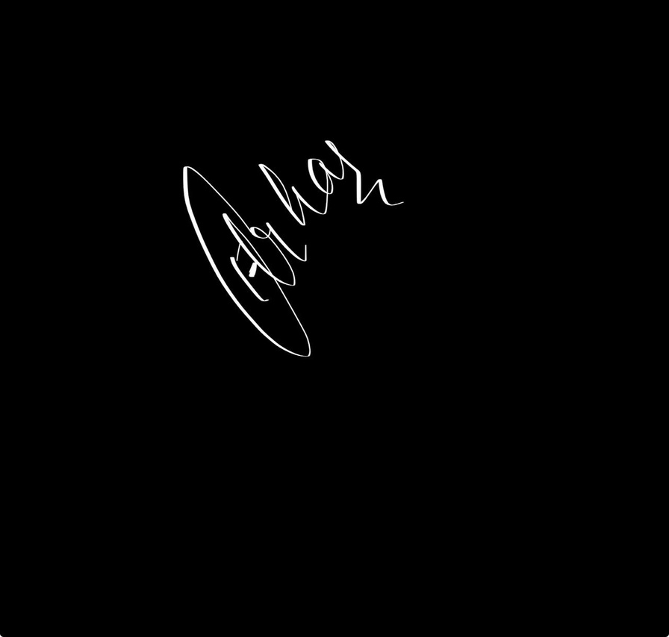
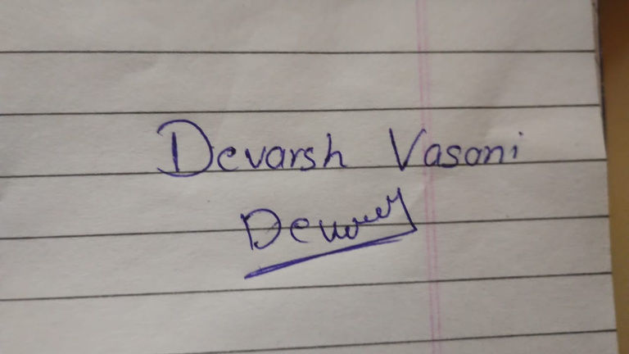
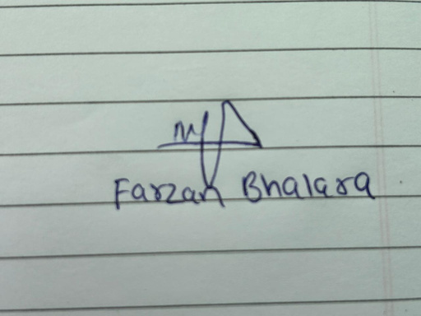
Honor Code:
• We declare that the work presented is our own work.
• We have not copied the work that someone else has done.
• Concepts, understanding, and insights we will be describing are our own.
• Wherever we have relied on existing work that is not our own, we have
provided a proper reference citation. We make this pledge truthfully.
• We know that violation of this solemn pledge can carry grave consequences.

Slide 4


01
Introduction
What are Polar Codes?
A class of error-correcting codes proposed by Erdal Arıkan in 2009.
First proven capacity achieving error correcting code for a large class of channels!
Encoding and decoding can be implemented with O(nlogn)O(nlog⁡n) complexity.
Why Polar Codes?
Efficient encoding & decoding algorithms.
Strong theoretical foundation.
Standardized in 5G for control channel communications.
First ASIC implementation
2012, A. Mishra, A. J. Raymond, L. G. Amaru, G. Sarkis, C. Leroux, P. Meinerzhagen, A. Burg, W. J. Gross
Simplified SC Decoding
2011,Amin Alamdar-Yazdi, Frank R. Kschischang
2014, Fast Hardware
Polar Decoders, by Gabi Sarkis, Pascal Giard, Alexander Vardy, Claude Thibeault, Warren J. Gross
Discovered in 2009
by Erdal Arıkan
List Decoding of Polar Codes
2015, Ido Tal, Alexander Vardy
sources: http://www.isip.ece.mcgill.ca/research/polar_codes.html

Slide 5
Polar codes are based on the idea of Channel Polarization.
Channel polarization includes the process of channel combining and channel splitting, that results in splitting into extremely noisy (bad channel ie channel with higher error probability) channel and perfectly noiseless(good channel ie channel with lower error probability) channel.
So, we transmit information bits through good channels and frozen bits through bad channels.

Slide 6
Reliability Sequence
Reliability sequence are derived from channel polarization, where channels split into good and bad.
The reliability sequence ranks the synthesized bit-channels of a polar code from least reliable to most reliable.
Select top K most reliable channels we transmit information bits from them
Remaining N−K indices we transmit frozen bits.
For N = 16 the reliability sequence is : 1 2 3 5 9 4 6 10 7 11 13 8 12 14 15 16

Slide 7

02
Encoding of polar codes

Slide 8
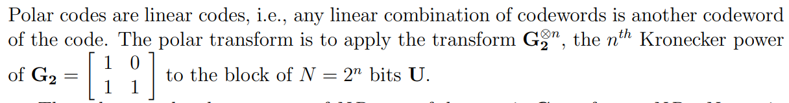
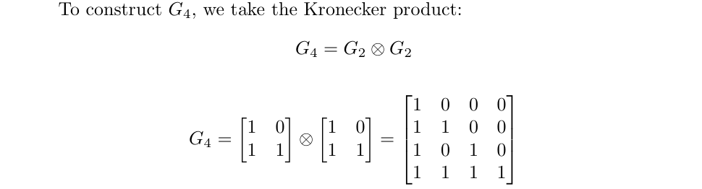

Slide 9
Each stage performs N/2 XORs.
There are log₂(N) stages.
Total: (N/2) × log₂(N) = O(N log N)
But here we have implemented encoding in N^2 Time complexity with using G-Matrix.

Slide 10


TO GET ENCODED SEQUENCE
Let the u1, u2, u3, u4 represent the message bits.
Now let us take an example with N = 8 and k = 4, that means for (N,K) = (8,4) there are N-k means 4 frozen bits
Now to send the message bits we will arrange it as per reliability sequence. For give example :
Msg = [0, 0, 0, m1 , 0, m2 , m3 , m4 ]
Zeroes in the array represents the channel that is least reliable.
+2 in the next tree diagram represent mod 2 sum i.e xor of both bits.

Slide 11
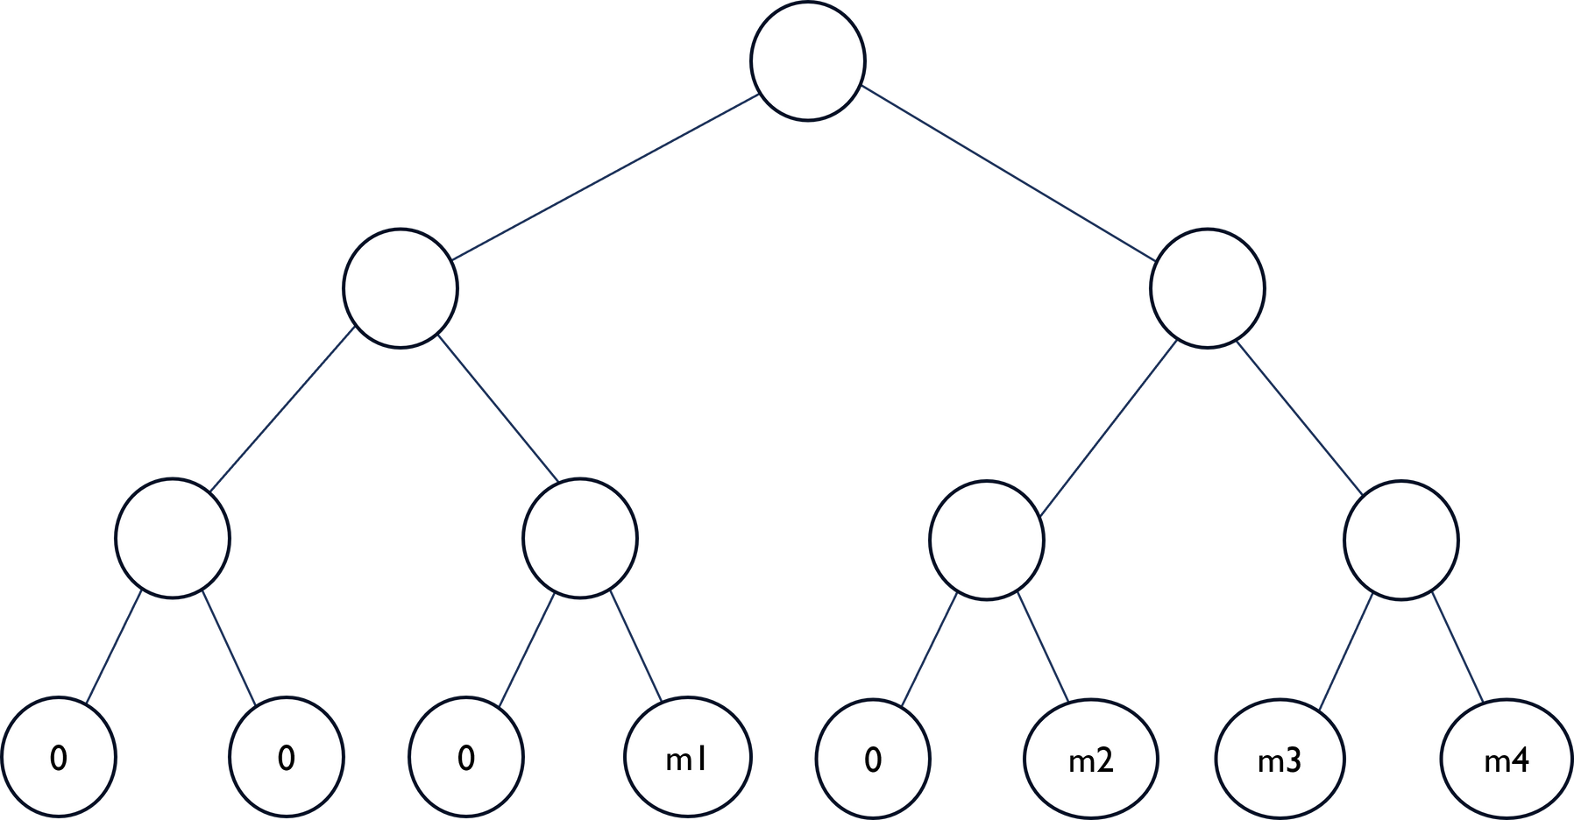
Now let’s visualize the encoding with a tree

Slide 12
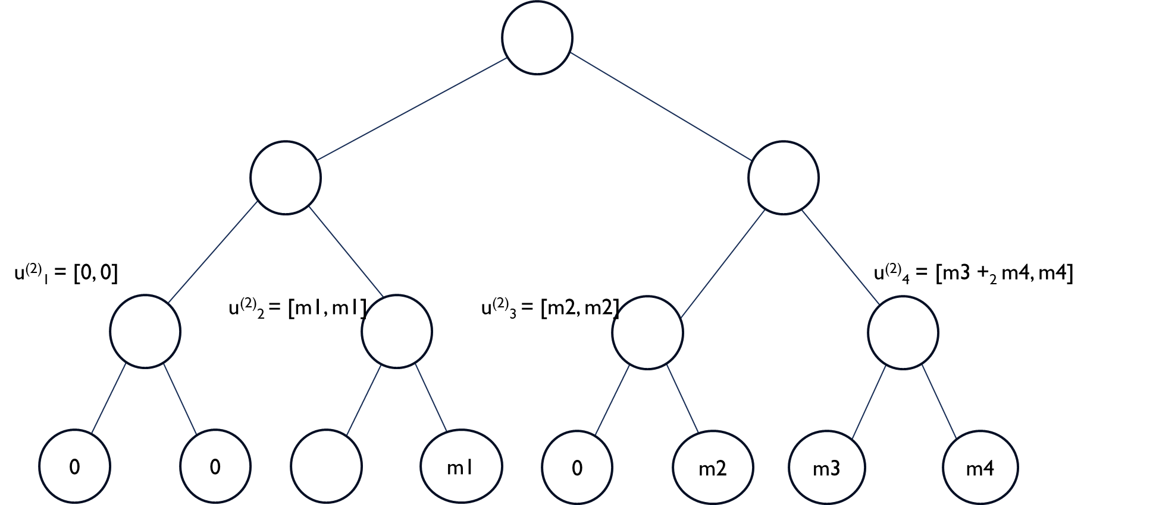
Here + subscript 2 implies modulo 2 addition

Slide 13
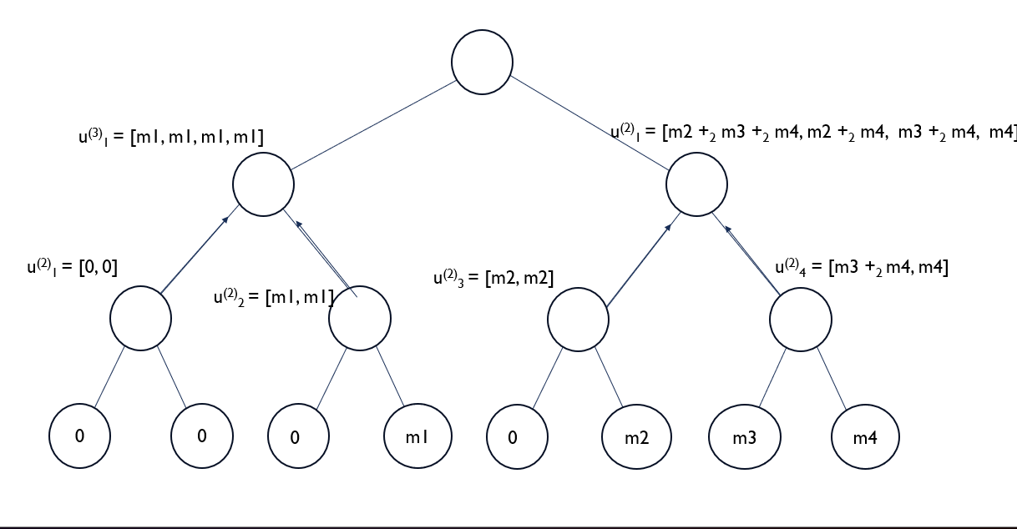

Slide 14
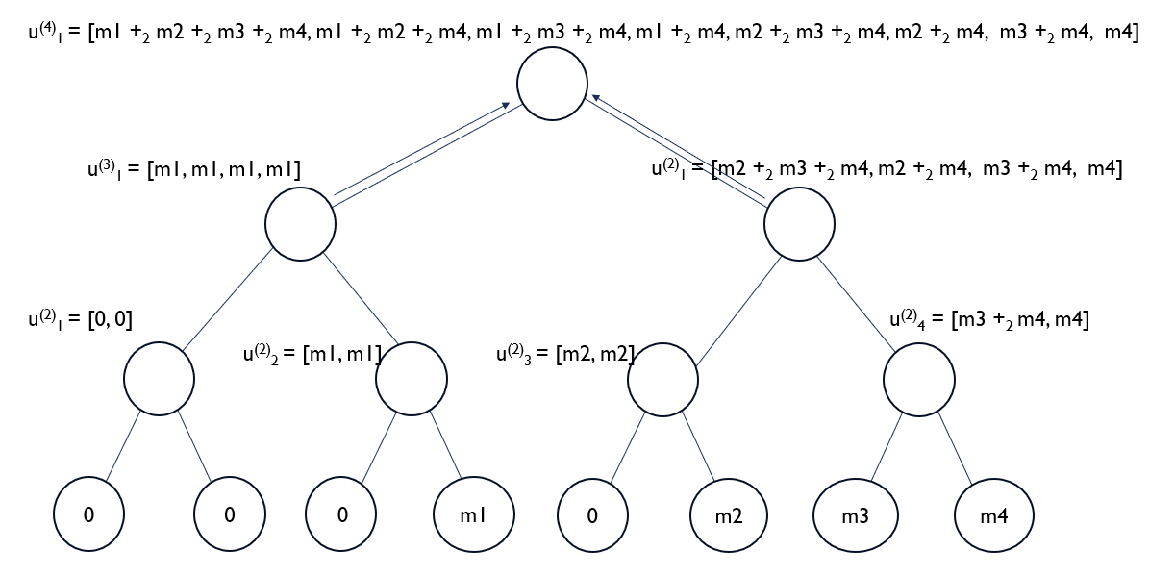

Slide 15
03
Decoding of polar codes

Slide 16

Part 1:
SC decoding Theory

Slide 17
Successive Cancellation Decoding (SC)
SC decoder which decodes one bit at a time, by using the bits already decoded. It is simple but not always accurate
The Successive Cancellation (SC) Decoder is the basic decoding algorithm for polar codes, which works sequentially.
Due to the sequential nature of the SC decoder, the decoding latency is relatively high.

Slide 18
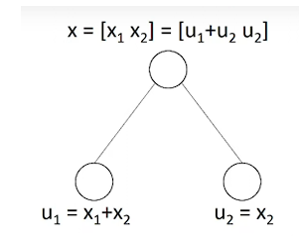
Basic Building Block of SC Decoder: N = 2
We start with a 2-bit input vector: x =[x1 x2] = [u1 ⊕u2 u2]
From the received symbols: u1 = x1 ⊕x2, u2 =x2

Slide 19
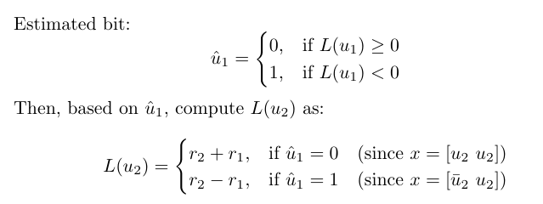
• Soft-In Soft-Out (SISO) decode u1 first (using a Single Parity Check (SPC)). •
Given u1(cap), decode u2 (as a Repetition (Rep) code).
Log-Likelihood Ratio (LLR) for u1: L(u1) = f(r1,r2) = sgn(r1) · sgn(r2) · min(|r1|,|r2|)
Log-Likelihood Ratio (LLR) for u2: L(u2)=g(r1,r2,u1)=r2+(1-2*u1).r1

Slide 20

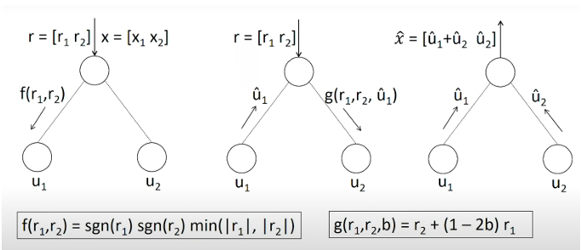
First, the received vector rN is decoded using a soft-decision decoding algorithm.
In soft-decision decoding, the reliability of each received bit is assessed using the Log-Likelihood Ratio (LLR).
These soft bits are then used to compute the estimated hard bits with the help of the F-function, G-function, and partial sums as shown below:

Slide 21
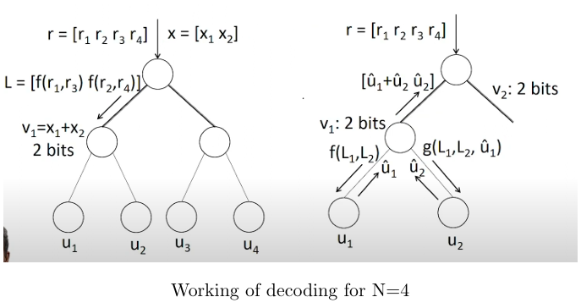
SC Decoder: N =4
As polar codes have recursive structure , we can apply this algorithm for decoding any length of codeword. Let us take an example of length 4 SC decoder and understand its behaviour.

Slide 22
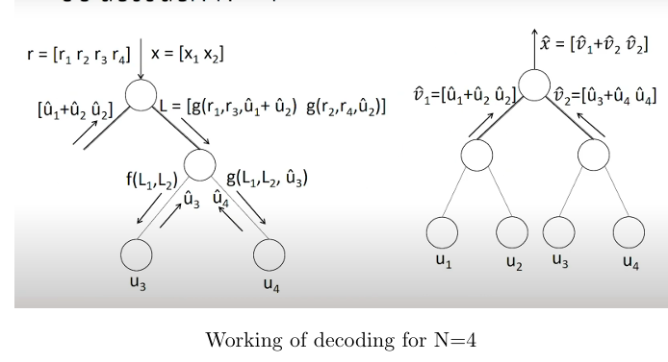

Slide 23
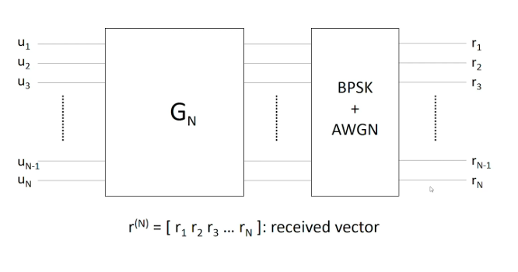
SC Decoder: General Polar Code
Now let us see how decoding works for a general polar code.

Slide 24
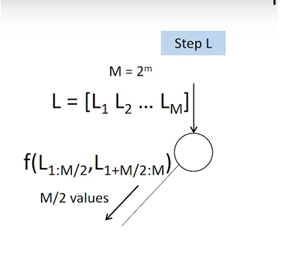
Operations at Each Interior Node
For any interior node present in the tree-like presentation, the following three operations take place:
1. Step L

Slide 25
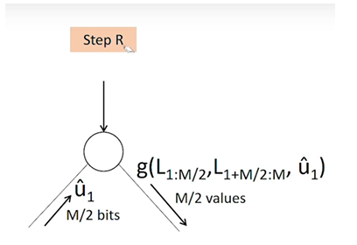
2. Step R

Slide 26

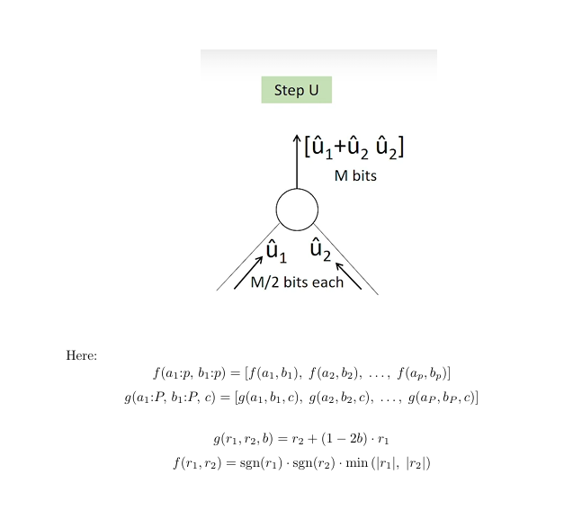
3. Step U

Slide 27
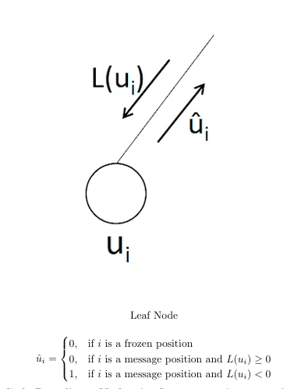
Operation at Leaf Node

Slide 28
Polar Code Decoding– Node-wise Summary:
At every node:
If not a leaf, perform the following steps in sequence:–
Perform Step L and move to the left child.
Once a decision is received from the left child, perform Step R and move to the right child
Once a decision is received from the right child, perform Step U and return to the parent.
If a leaf node, make the decision and return to the parent

Slide 29
Decoding of Polar Codes
Part 2: SCL Decoding Theory

Slide 30
Successive Cancellation List Decoder (SCL)
SCL(Successive Cancellation List Decoder) somewhat is similar to SC decoding,given the fact that now it maintains a list to store more than one possible codewords that are most likely to be transmitted. SCL decoding typically results in better error correction performance compared to SC decoding, especially in situations with high noise or challenging channel conditions.In SCL path represents a hypothesis about the transmitted codeword, and the decoder explores the multiple possible hypothesis simultaneously

Slide 31
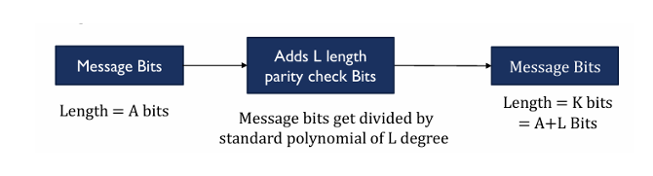
CRC-Aided SCL Decoding
CRC is used to select a single codeword from the list of most likely possible codewords.
• During polar encoding we would be adding bits for CRC:
• The nearest (most likely) correct codeword is selected using the CRC check.
• If no codeword in the list passes the CRC check, it is declared a decoding failure.

Slide 32
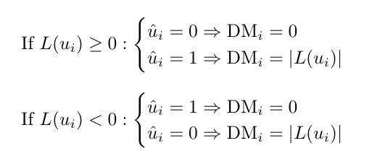
List Decoding, Decision Metric, and Path Metric
• Now we will proceed to see how we produce multiple codewords at decoder?
• In Polar SCL decoding, both decisions (0 and 1) for each bit are considered
. • Assign a Decision Metric (DM) for each possible bit decision:

Slide 33
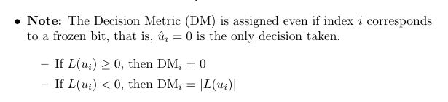
• Path Metric (PM): sum of all decision metrics along a decoding path. PM= summation of (DMi)

Slide 34
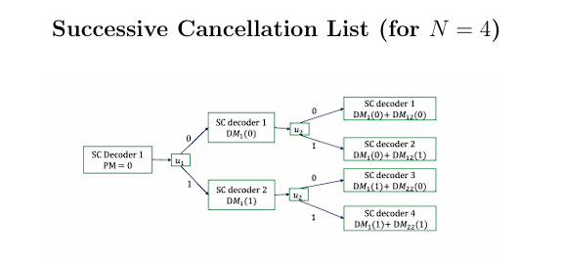

Slide 35
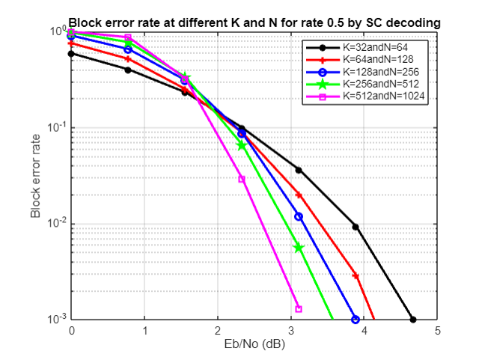
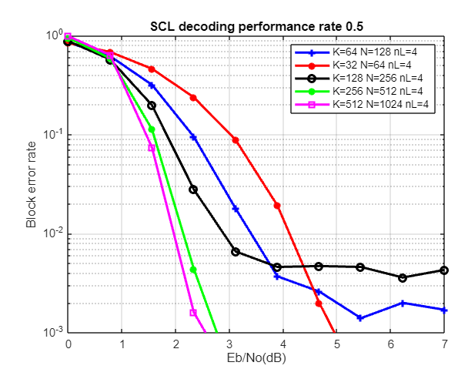
SC VS SCL Graph Performance

Slide 36
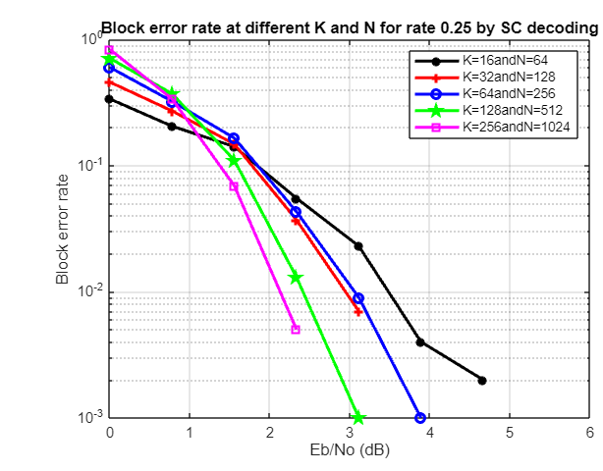
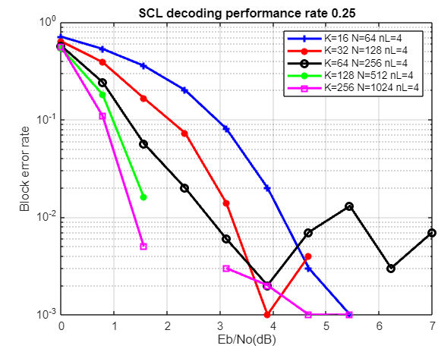
SC VS SCL Decoding Performance

Slide 37
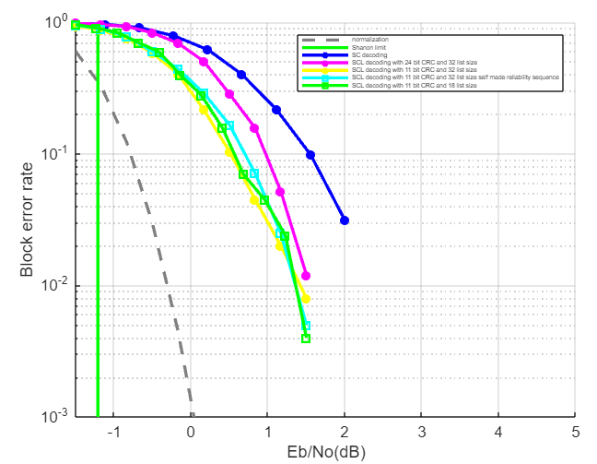
Normalization and Shanon limit

Slide 38
Citations
https://ieeexplore.ieee.org/document/5075875
https://medium.com/5g-nr/polar-codes-703336e9f26b
https://archive.nptel.ac.in/noc/courses/noc19/SEM1/noc19-ee29/
https://www.ijeat.org/wp-content/uploads/papers/v9i1/A1233109119.pdf
https://ieeexplore.ieee.org/document/6823688
https://studylib.net/doc/27190911/implementation-of-plor-codes-in-5g
Reference from last year project of Mentor:Darpan Lunagariya ID:(202201462)

Slide 39
Referred Video lectures of Prof. Andrew Thangrajan on Polar codes fron NPTEL
https://simons.berkeley.edu/sites/default/files/docs/2689/slidesarikan.pdf
Prof Erdal Arikan Slides on Polar Codes

